Slide 1
Lecture 11: Recovery System

Slide 2
Recovery System
Failure Classification
Storage Structure
Recovery and Atomicity
Log-Based Recovery
Remote Backup Systems

Slide 3
Failure Classification
Transaction failure :
Logical errors: transaction cannot complete due to some internal error condition
System errors: the database system must terminate an active transaction due to an error condition (e.g., deadlock)
System crash: a power failure or other hardware or software failure causes the system to crash.
Fail-stop assumption: non-volatile storage contents are assumed to not be corrupted by system crash
Database systems have numerous integrity checks to prevent corruption of disk data
Disk failure: a head crash or similar disk failure destroys all or part of disk storage
Destruction is assumed to be detectable: disk drives use checksums to detect failures

Slide 4
Recovery Algorithms
To determine how system should recover from failures, we need to first identify failure modes of devices storing data.
Then we can propose recovery algorithms.
Consider transaction T_{i} that transfers $50 from account A to account B
Two updates: subtract 50 from A and add 50 to B
A failure may occur any time, after one of these modifications have been made, or after both of them are made.
Recovery algorithms have two parts
Actions taken during normal transaction processing to ensure enough information exists to recover from failures
Actions taken after a failure to recover the database contents to a state that ensures atomicity, consistency and durability

Slide 5
Storage Structure
Volatile storage:
does not survive system crashes
examples: main memory, cache memory
Nonvolatile storage:
survives system crashes
examples: disk, tape, flash memory, RAID systems non-volatile (battery backed up) RAM
but may still fail, losing data → Remote backups
Stable storage:
a mythical form of storage that survives all failures
approximated by maintaining multiple copies on distinct nonvolatile media

Slide 6
Stable-Storage Implementation
Maintain multiple copies of each block on separate disks
copies can be at remote sites to protect against disasters such as fire or flooding.
Failure during data transfer can still result in inconsistent copies: Block transfer can result in
Successful completion
Partial failure: destination block has incorrect information
Total failure: destination block was never updated
Protecting storage media from failure during data transfer (one solution):
Execute output operation as follows (assuming two copies of each block):
Write the information onto the first physical block.
When the first write successfully completes, write the same information onto the second physical block.
The output is completed only after the second write successfully completes.
Notes:
6

Slide 7
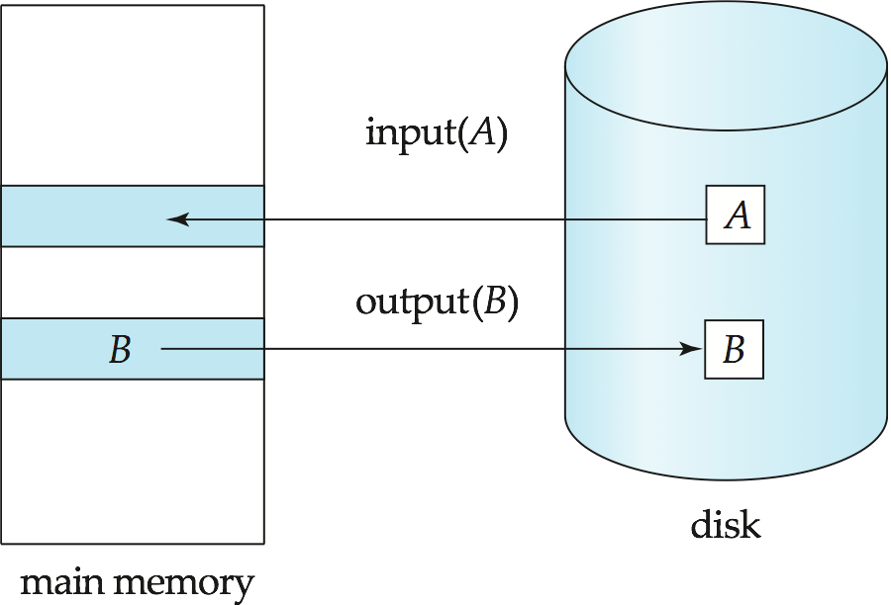

Data Access

Slide 8

Data Access
Physical blocks are those blocks residing on the disk.
Buffer blocks are the blocks residing temporarily in main memory.
Block movements between disk and main memory are initiated through the following two operations:
input(B) transfers the physical block B from disk to main memory.
output(B) transfers the buffer block B to the disk, and replaces the appropriate physical block there.
We assume, for simplicity, that each data item fits in, and is stored inside, a single block.
The blocks residing on the disk are referred to as physical blocks
Blocks residing in main memory are referred to as buffer blocks
Area of main memory where blocks reside is called the disk buffer

Slide 9
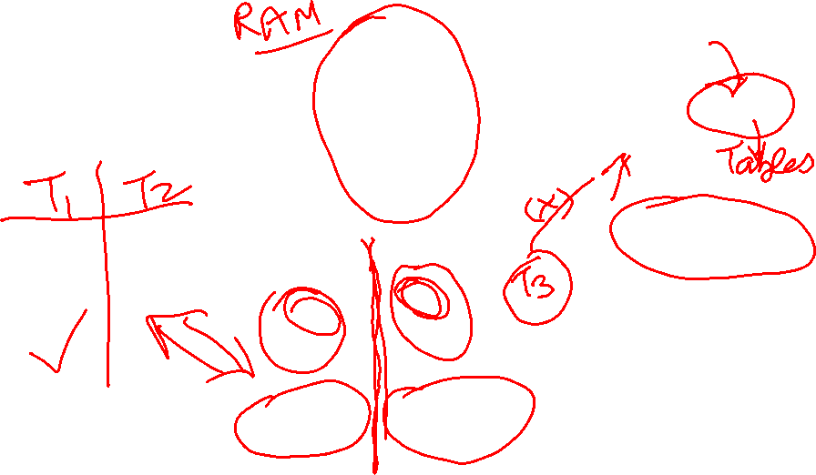
Example of Data Access
Physical
Blocks
Disk buffer
Buffer Block A
input(A)
X
A
Logs
Buffer Block B
Y
B
output(B)
read(X)
write(Y)
Stable Storage
x₂
x₁
y₁
work area
of T₁
work area
of T₂
memory
disk

Slide 10
Data Access (Cont.)
Each transaction T_{i} has its private work-area in which local copies of all data items accessed and updated by it are kept.
T_{i}'s local copy of a data item X is called x_{i.}
Transferring data items between system buffer blocks and its private work-area is done by:
read(X) assigns the value of data item X to the local variable x_{i}.
write(X) assigns the value of local variable x_{i} to data item {X} in the buffer block.
Note: output(X_{j}) need not immediately follow write(X). System can perform the output operation when it deems fit.
Transactions
Must perform read(X) before accessing X for the first time (subsequent reads can be from local copy)
write(X) can be executed at any time before the transaction commits

Slide 11
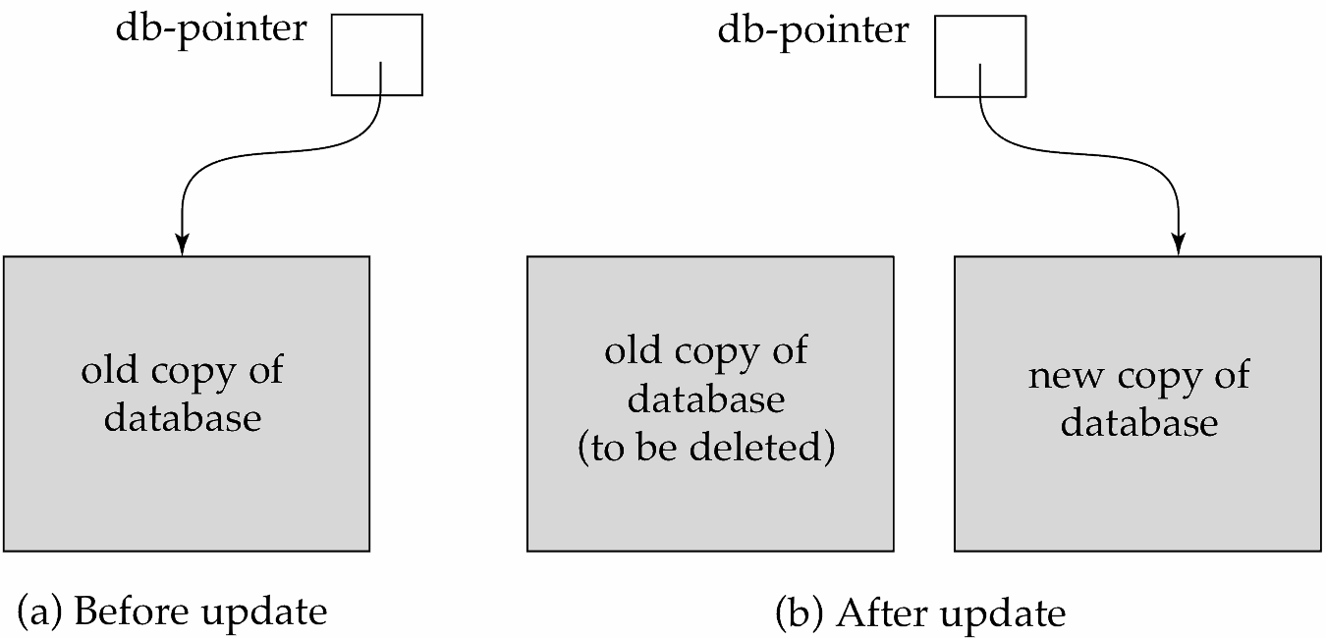
Recovery and Atomicity
Again, consider transaction T_{i} that transfers $50 from account A to account B. Two updates: subtract 50 from A and add 50 to B
To ensure atomicity despite failures, we first output information describing the modifications to stable storage without modifying the database itself(Logs)
Helps ensure that all changes made by committed transactions are safe.
We will study log-based recovery mechanisms in detail
We first present key concepts
And then present the actual recovery algorithm
Less used alternative: shadow-copy and shadow-paging (brief details in book)
shadow-copy

Slide 12

Log-Based Recovery
A log is kept on stable storage.
The log is a sequence of log records, and maintains a record of update activities on the database.
Log records has following fields:
Transaction Identifier
Data Item identifier
Old value
New value
When transaction T_{i} starts, it registers itself by writing a <T_{i} start>log record
Before T_{i} executes write(X), a log record <T_{i}, X, V₁, V₂> is written, where V₁ is the value of X before the write (the old value), and V₂ is the value to be written to X (the new value).
When T_{i} finishes it last statement, the log record <T_{i} commit> is written

Slide 13
Database Modification
Two approaches using logs
Deferred database modification
Immediate database modification
Understanding role of log records in recovery. Sequence of Transactions:
Transaction performs computations in its own private part of main memory
Transaction modifies data block in disk buffer in main memory
Database executes write operation that writes data block to disk
Database modification:
#2 and #3 only

Slide 14
Database Modification
The immediate-modification scheme allows updates of an uncommitted transaction to be made to the buffer, or the disk itself, before the transaction commits
Update log record must be written before database item is written
We assume that the log record is output directly to stable storage
(Will see later that how to postpone log record output to some extent)
Output of updated blocks to stable storage can take place at any time before or after transaction commit
Order in which blocks are output can be different from the order in which they are written.

Slide 15
Database Modification
The deferred-modification scheme performs updates to buffer/disk only at the time of transaction commit
Simplifies some aspects of recovery
But has overhead of storing local copy
In this class, we will review recovery algorithms supporting Immediate modification
All database modifications must be written to logs
Undo Log: Used for rollback, to set data item to old value, ensuring atomicity (all or none)
Redo Log: Used for roll-forward, to set data item to new value, ensuring durability

Slide 16
Concurrency Control and Recovery
With concurrent transactions, all transactions share a single disk buffer and a single log
A buffer block can have data items updated by one or more transactions
We assume that if a transaction T_{i} has modified an item, no other transaction can modify the same item until T_{i} has committed or aborted
i.e. the updates of uncommitted transactions should not be visible to other transactions
Otherwise how to perform undo if T1 updates A, then T2 updates A and commits, and finally T1 has to abort?
Can be ensured by obtaining exclusive locks on updated items and holding the locks till end of transaction (strict two-phase locking)
Log records of different transactions may be interleaved in the log.

Slide 17
Transaction Commit
A transaction is said to have committed when its commit log record is output to stable storage
all previous log records of the transaction must have been output already
Writes performed by a transaction may still be in the buffer when the transaction commits, and may be output later

Slide 18
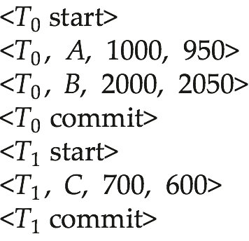
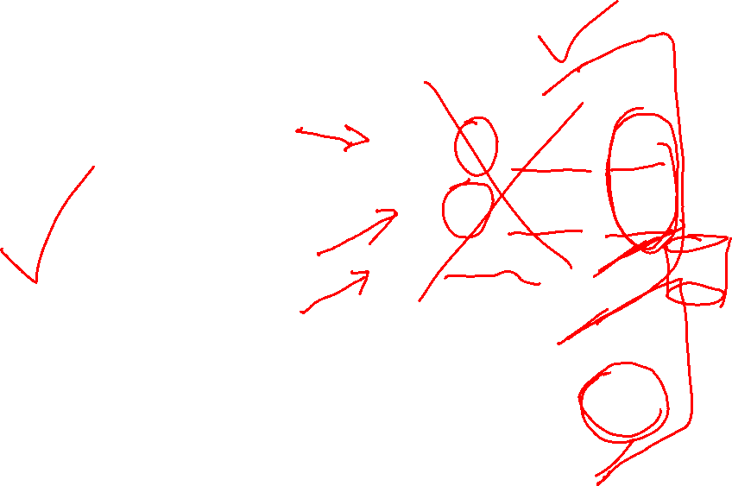
Immediate Database Modification Example

Slide 19
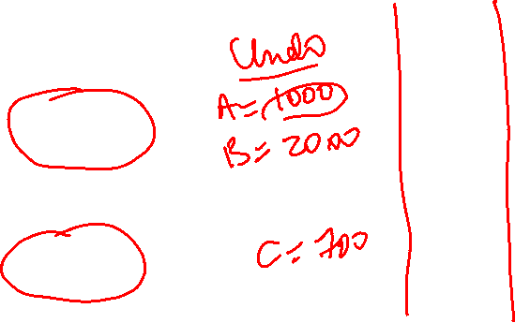
Immediate Database Modification Example
Log Database
<T₀ start>
<T₀, A, 1000, 950>
<T_{o}, B, 2000, 2050
<T₀ commit>
A = 950
B = 2050
<T₁ start>
<T₁, C, 700, 600>
<T₁ commit>
C = 600

Slide 20

Undo and Redo Operations
Undo of a log record <T_{i}, X, V₁, V₂> writes the old value V₁ to X
Redo of a log record <T_{i}, X, V₁, V₂> writes the new value V₂ to X
Undo and Redo of Transactions
undo(T_{i}) restores the value of all data items updated by T_{i} to their old values, going backwards from the last log record for T_{i}
each time a data item X is restored to its old value V a special log record <T_{i} , X, V> is written out
when undo of a transaction is complete, a log record <T_{i} abort> is written out.
redo(T_{i}) sets the value of all data items updated by T_{i} to the new values, going forward from the first log record for T_{i}
No logging is done in this case

Slide 21

Undo and Redo on Recovering from Failure
When recovering after failure:
Transaction T_{i} needs to be undone if the log
contains the record <T_{i} start>,
but does not contain either the record <T_{i} commit> or <T_{i} abort>.
Transaction T_{i} needs to be redone if the log
contains the records <T_{i} start>
and contains the record <T_{i} commit> or <T_{i} abort>
Note that If transaction T_{i} was undone earlier and the <T_{i} abort> record written to the log, and then a failure occurs, on recovery from failure, T_{i} is redone
such a redo redoes all the original actions including the steps that restored old values
Known as repeating history
Seems wasteful, but simplifies recovery greatly

Slide 22

Our banking example

Slide 23
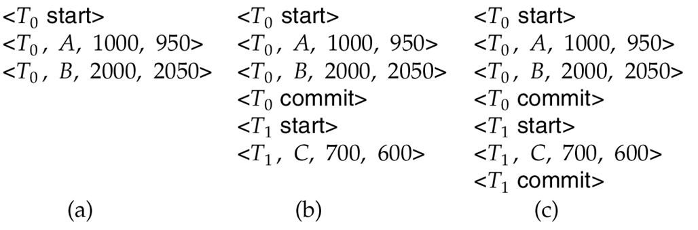
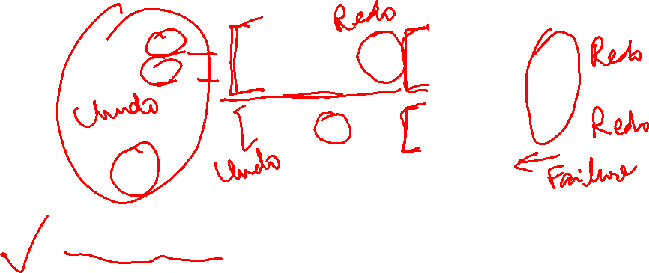
Immediate DB Modification Recovery
Below we show the log as it appears at three instances of time.
Recovery actions in each case above are:
(a) No commit or abort found. undo (T₀): B is restored to 2000 and A to 1000, and log records <T₀, B, 2000>, <T₀, A, 1000>, <T₀, abort> are written out
(b) Commit found, no abort: redo (T₀) and undo (T₁): A and B are set to 950 and 2050 and C is restored to 700. Log records <T₁, C, 700>, <T₁, abort> are written out.
(c) Commit found : redo (T₀) and redo (T₁): A and B are set to 950 and 2050
respectively. Then C is set to 600

Slide 24
Checkpoints
Redoing/undoing all transactions recorded in the log can be very slow
processing the entire log is time-consuming if the system has run for a long time
we might unnecessarily redo transactions which have already output their updates to the database.
Streamline recovery procedure by periodically performing checkpointing
Output all log records currently residing in main memory onto stable storage.
Output all modified buffer blocks to the disk.
Write a log record < checkpoint L> onto stable storage where L is a list of all transactions active at the time of checkpoint.
All updates are stopped while doing checkpointing

Slide 25
Checkpoints (continued)
During recovery we need to consider only the most recent transaction T_{i} that started before the checkpoint, and transactions that started after T_{i}.
Scan backwards from end of log to find the most recent <checkpoint L> record
Only transactions that are in L or started after the checkpoint need to be redone or undone
Transactions that committed or aborted before the checkpoint already have all their updates output to stable storage.
Some earlier part of the log may be needed for undo operations
Continue scanning backwards till a record <T_{i} start> is found for every transaction T_{i} in L.
Parts of log prior to earliest <T_{i} start> record above are not needed for recovery, and can be erased whenever desired.

Slide 26
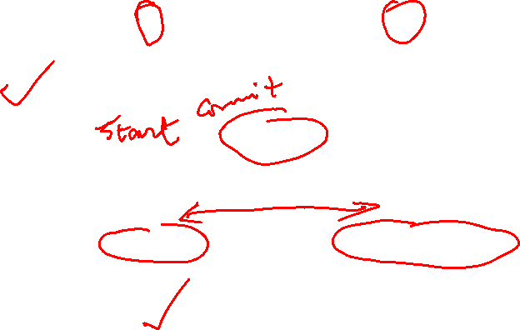
Example of Checkpoints
T_{c}
T_{f}
T₁ can be ignored (updates already output to disk due to checkpoint)
T₂ and T₃ redone.
T₄ undone
T₁
T₂
T₃
T₄
checkpoint
system failure

Slide 27
Recovery Algorithm
So far: we covered key concepts
Now: we present the components of the basic recovery algorithm

Slide 28
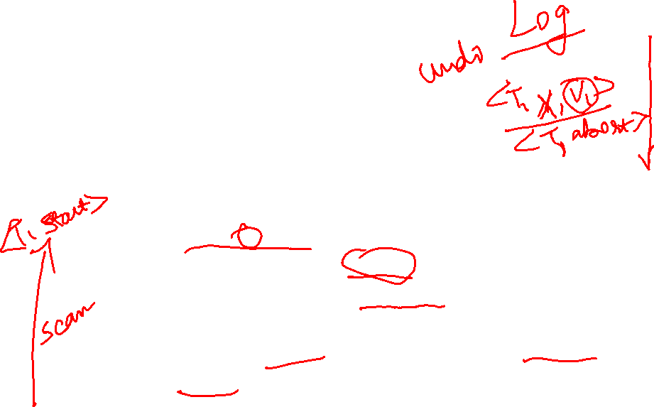
Recovery Algorithm
Logging (during normal operation):
<T_{i} start> at transaction start
<T_{i}, X_{j}, V₁, V₂> for each update, and
<T_{i} commit> at transaction end
Transaction rollback (during normal operation)
Let T_{i} be the transaction to be rolled back
Scan log backwards from the end, and for each log record of T_{i} of the form <T_{i}, X_{j}, V₁, V₂>
perform the undo by writing V₁ to X_{j},
write a redo-only log record <T_{i} , X_{j}, V₁>
such log records are called compensation log records
Once the record <T_{i} start> is found stop the scan and write the log record <T_{i} abort>

Slide 29
Recovery Algorithm (Cont.)
Recovery from failure: Two phases
Redo phase: replay updates of all transactions, whether they committed, aborted, or are incomplete, including transaction rollback during normal operations
Undo phase: undo all incomplete transactions

Slide 30
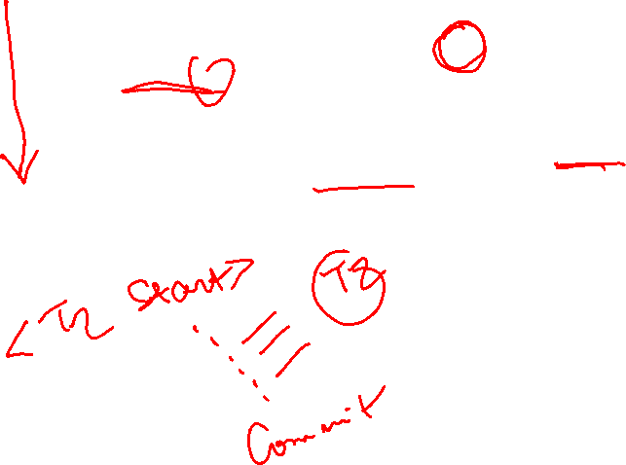
Recovery Algorithm (Cont.)
Redo phase:
Find last <checkpoint L> record, and set undo-list to L.
Scan forward from above <checkpoint L> record
Whenever a record <T_{i}, X_{j}, V₁, V₂> , or a redo-only record <T_{i}, X_{j}, V₂> is found, redo it by writing V₂ to X_{j}
Whenever a log record <T_{i} start> is found, add T_{i} to undo-list
Whenever a log record <T_{i} commit> or <T_{i} abort> is found, remove T_{i} from undo-list
At end of redo phase, undo-list contains only list of all transactions that are incomplete

Slide 31
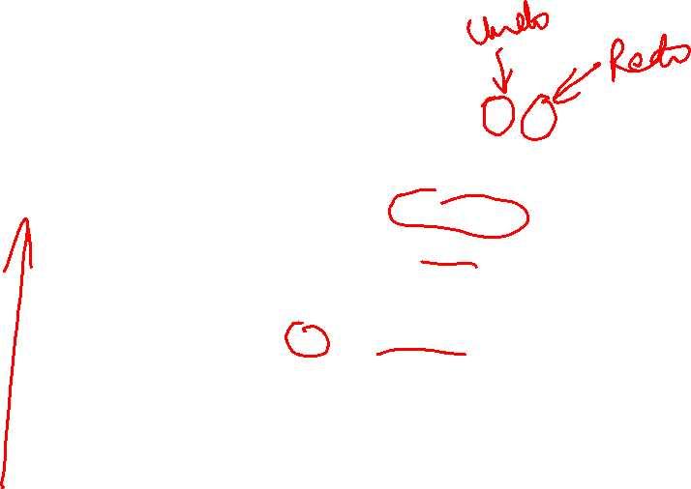
Recovery Algorithm (Cont.)
Undo phase:
Scan log backwards from end
Whenever a log record <T_{i}, X_{j}, V₁, V₂> is found where T_{i} is in undo-list perform same actions as for transaction rollback:
Perform undo by writing V₁ to X_{j}.
Write a log record <T_{i} , X_{j}, V₁>
Whenever a log record <T_{i} start> is found where T_{i} is in undo-list,
Write a log record <T_{i} abort>
Remove T_{i} from undo-list
Stop when undo-list is empty
i.e. <T_{i} start> has been found for every transaction in undo-list
After undo phase completes, normal transaction processing can commence

Slide 32
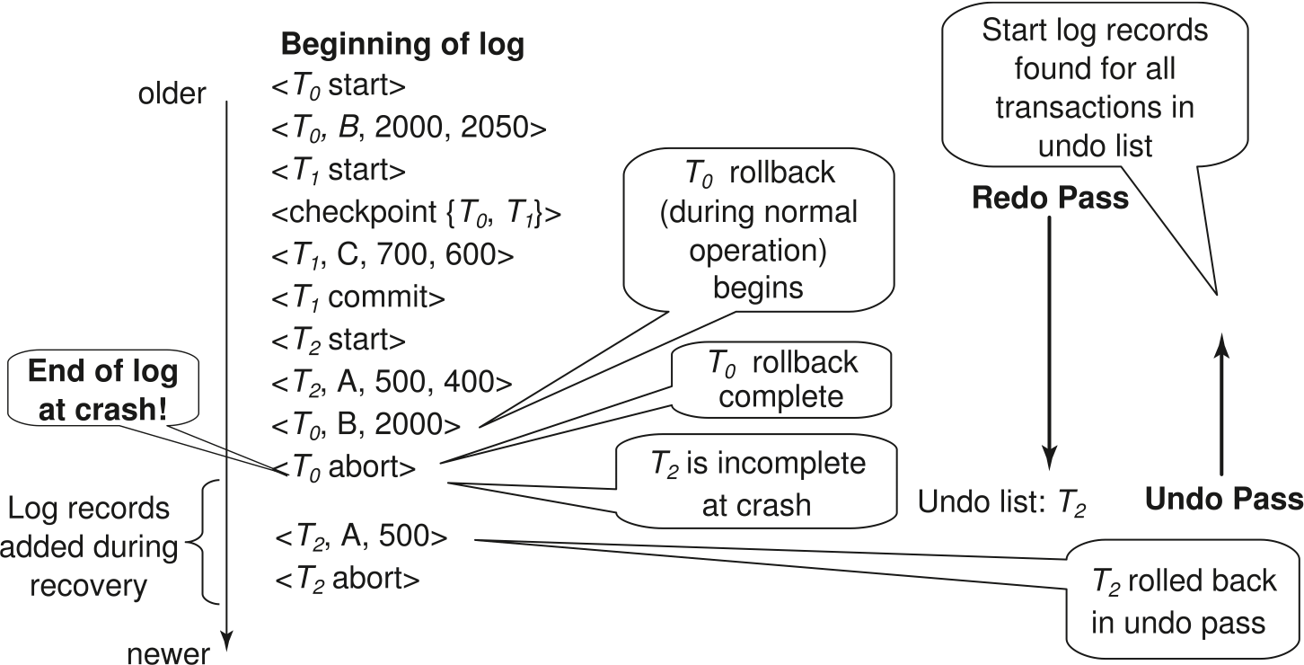
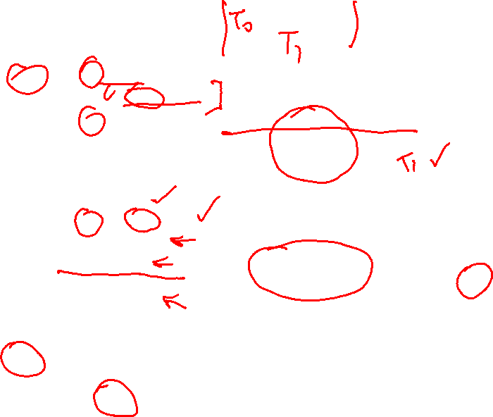
Example of Recovery
Read Section 16.4 for more details

Slide 33

Recovery Example - Class Exercise A
Show the steps taken by the recovery manger to recover from the crash
Log | Redo Phase | Undo Phase (undo T0)
<T0 start>
<T0,B,2000,2050>
<T1 start>
<checkpoint L {T0,T1}>
<T1,C,700,600>
<T1 commit>
<T2 start>
<T2,A,500,400>
<T0,B,2000>
<T0 abort>

Slide 34

Recovery Example - Class Exercise A
Show the steps taken by the recovery manger to recover from the crash
Log | Redo Phase | Undo Phase (undo T0)
<T0 start>
<T0,B,2000,2050>
<T1 start>
<checkpoint L {T0,T1}> | 1. L = T0, T1
<T1,C,700,600> | 2. C = 600
<T1 commit> | 3. L = T0 (Remove T1, Commit found)
<T2 start> | L = T0, T2 (Add T2, start found) | 8. T2 Start found add <T2 abort> to log
<T2,A,500,400> | 4. A = 400 | 7. T2 = 500 add <T2, A, 500> to log
<T0,B,2000> | 5. B = 2000
<T0 abort> | 6. L = T2 (Remove T0, Abort found)
<T2, A, 500>
<T2, abort>

Slide 35
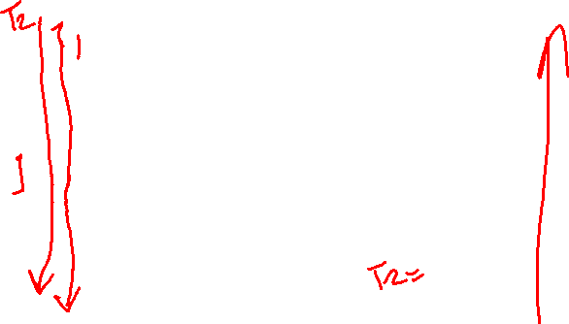
Class Exercise – Example B
Show the steps taken by the recovery manger to abort transaction T2
Log | Undo Phase (undo T2)
<T2 start>
<T1,p2,100,200>
<T1,p1,50,60>
<T2,p5,100,200>
<T3,p4,100,200>
<T3 commit>
<T2,p5,200,300>
<T2,p3,200,300>
XXT2 CRASH XX

Slide 36
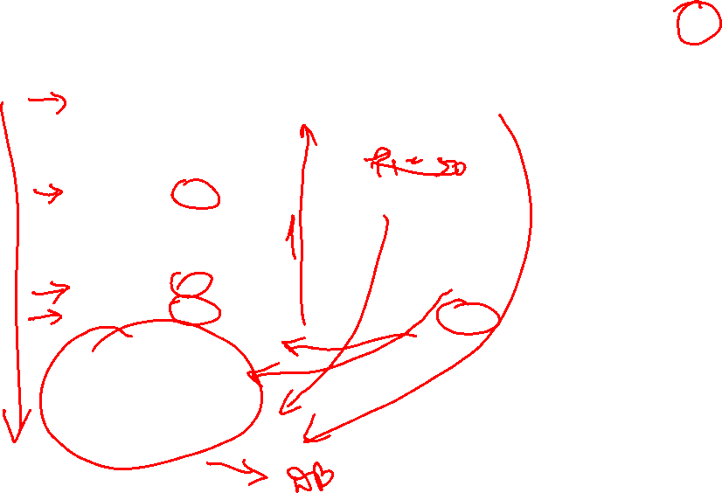
Class Exercise – Example B
Show the steps taken by the recovery manger to abort transaction T2
Log | Undo Phase (undo T2)
<T2 start> | 4- T2 abort
<T1,p2,100,200>
<T1,p1,50,60>
<T2,p5,100,200> | 3- p5 = 100
<T3,p4,100,200>
<T3 commit>
<T2,p5,200,300> | 2- p5 = 200
<T2,p3,200,300> | 1- P3 = 200
<T2,p3,200>
<T2,p5,200>
<T2,p5,100>
<T2 abort>

Slide 37
Log Record Buffering
High overhead when writing logs to stable storage
Output in units of blocks, which are not always full, causing large output
Log record buffering: log records are buffered in main memory, instead of being output directly to stable storage.
Log records are output to stable storage when a block of log records in the buffer is full, or a log force operation is executed.
Log force is performed to commit a transaction by forcing all its log records (including the commit record) to stable storage.
Several log records can thus be output using a single output operation, reducing the I/O cost.

Slide 38
Database Buffering
Database maintains an in-memory buffer of data blocks
When a new block is needed, if buffer is full an existing block needs to be removed from buffer
If the block chosen for removal has been updated, it must be output to disk
The recovery algorithm supports the no-force policy: i.e., updated blocks need not be written to disk when transaction commits
force policy: requires updated blocks to be written at commit
More expensive commit
The recovery algorithm supports the steal policy:i.e., blocks containing updates of uncommitted transactions can be written to disk, even before the transaction commits

Slide 39
Buffer Management (Cont.)
Database buffer can be implemented either
in an area of real main-memory reserved for the database, or
in virtual memory
Implementing buffer in reserved main-memory has drawbacks:
Memory is partitioned before-hand between database buffer and applications, limiting flexibility.
Needs may change, and although operating system knows best how memory should be divided up at any time, it cannot change the partitioning of memory.

Slide 40
Failure with Loss of Nonvolatile Storage
So far we assumed no loss of non-volatile storage
Technique similar to checkpointing used to deal with loss of non-volatile storage
Periodically dump the entire content of the database to stable storage
No transaction may be active during the dump procedure; a procedure similar to checkpointing must take place
Output all log records currently residing in main memory onto stable storage.
Output all buffer blocks onto the disk.
Copy the contents of the database to stable storage.
Output a record <dump> to log on stable storage.

Slide 41
Recovering from Failure of Non-Volatile Storage
To recover from disk failure
restore database from most recent dump.
Consult the log and redo all transactions that committed after the dump
Can be extended to allow transactions to be active during dump; known as fuzzy dump or online dump
Similar to fuzzy checkpointing

Slide 42
Remote Backup Systems

Slide 43

Remote Backup Systems
Remote backup systems provide high availability by allowing transaction processing to continue even if the primary site is destroyed.

Slide 44

Remote Backup Systems (Cont.)
Detection of failure: Backup site must detect when primary site has failed
to distinguish primary site failure from link failure maintain several communication links between the primary and the remote backup.
Heart-beat messages
Transfer of control:
To take control over backup site first perform recovery using its copy of the database and all the log records it has received from the primary.
Thus, completed transactions are redone and incomplete transactions are rolled back.
When the backup site takes over processing it becomes the new primary
To transfer control back to old primary when it recovers, old primary must receive redo logs from the old backup and apply all updates locally.

Slide 45
Reading and Assignment
No. | Date | Topics and Required Reading | Assignments
 |  |  |  | start of class day

